Slide 1
Before we start…
Please fill out and submit this Google form:
https://forms.gle/c6LD6TxQ6voC4UR59
Feel free to submit as many times as you like.

Slide 2
CSE514 – Datamining Fall 2022 Naïve Bayes Classifier
Cynthia Ma
Department of Computer Science
Washington University in St. Louis
czma@wustl.edu

Slide 3
Quick admin follow-up
Programming assignment 1 accuracy threshold
Variance explained on training data must be >10% for two of your univariate models, and your multivariate model
Variance of concrete strength on random subset of 900 samples ~270-290
MSE must therefore be < ~245-260 to achieve > 10%VE

Slide 4
Descriptive Statistics
Measures of Central Tendency
Mean
Median
Mode
Measures of Variability
Variance / standard deviation
Range / minimum and maximum values
Skewness
Kurtosis

Slide 5
Inferential Statistics
Estimating parameters
Taking a statistic from your sample data and using it to say something about the population parameters
Ex. Sample mean is population mean
Hypothesis testing
Compare populations
Ex. Is the mean height of students sitting in the front different from the those who sit near the back?
Assess relationships between variables
Ex. Does the height of student predict where they’ll sit?

Slide 6
Thought experiment part 1
A coin will be flipped
What’s the probability that the next flip is heads?
Frequentist: There is no probability; I have no data on how often the coin lands on heads
Bayesian: 50%, because I assume the coin is fair

Slide 7
Thought experiment part 2
The flipper tells you the coin is fair. They flip the coin without revealing the result to you.
What’s the probability that the next flip is heads?
Frequentist: There is no probability. I may not know the answer, but it’s either heads or tails
Bayesian: 50%, because the truth is unknown to me

Slide 8
Thought experiment part 3
The coin is revealed to be heads, 10 times in a row.
What is the probability that the next flip is heads?
Frequentist: I have 10 samples, and 100% of them are heads. Therefore, the probability of the coin landing heads is 100%
Bayesian: I started with the prior belief that the coin is fair. 10 heads in a row has updated my belief so that…

Slide 9
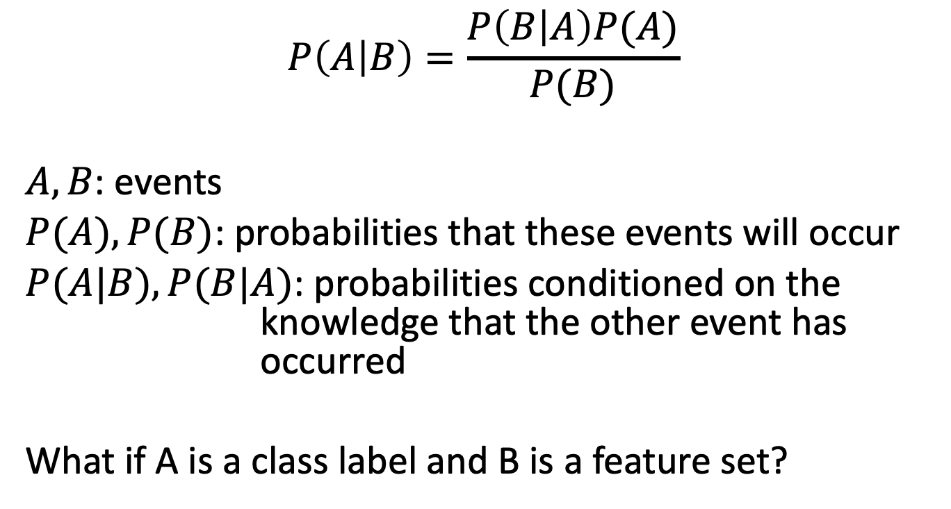
Bayes theorem
$$P\left(A | B\right)=\frac{P\left(B | A\right)P(A)}{P(B)}$$
$A, B$: events
$P(A), P(B)$: probabilities that these events will occur
$P(A|B), P(B|A)$: probabilities conditioned on the knowledge that the other event has occurred
What if A is a class label and B is a feature set?

Slide 10
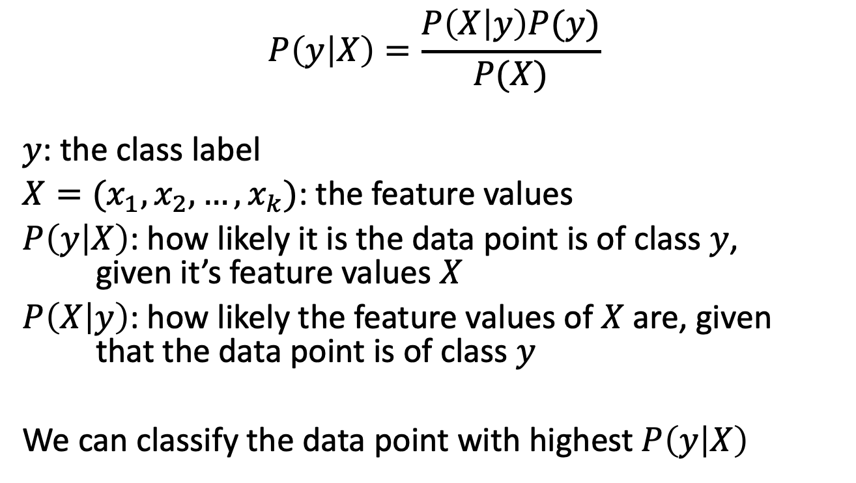
Bayes theorem for classification
$$P\left(y | X\right)=\frac{P\left(X | y\right)P(y)}{P(X)}$$
$y$: the class label
$X=(x_{1}, x_{2}, …, x_{k})$: the feature values
$P\left(y | X\right)$: how likely it is the data point is of class $y$, given it’s feature values $X$
$P\left(X | y\right)$: how likely the feature values of $X$ are, given that the data point is of class $y$
We can classify the data point with highest $P\left(y | X\right)$

Slide 11
Common types
Bernoulli Naïve Bayes
Feature values are binary/Boolean
Multinomial Naïve Bayes
Feature values are frequencies/discrete counts
Gaussian Naïve Bayes
Feature values are continuous and follow a normal distribution

Slide 12
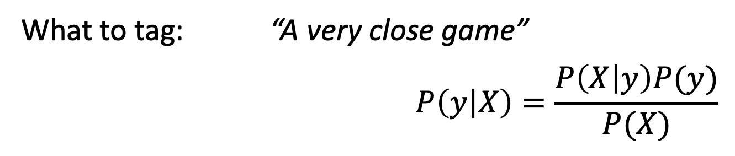
Text Classification
Text | Tag
"A great game" | Sports
"The election was over" | Not Sports
"Very clean match" | Sports
"A clean but forgettable game" | Sports
"It was a close election" | Not Sports
What to tag: “A very close game”
$$P\left(y | X\right)=\frac{P\left(X | y\right)P(y)}{P(X)}$$

Slide 13
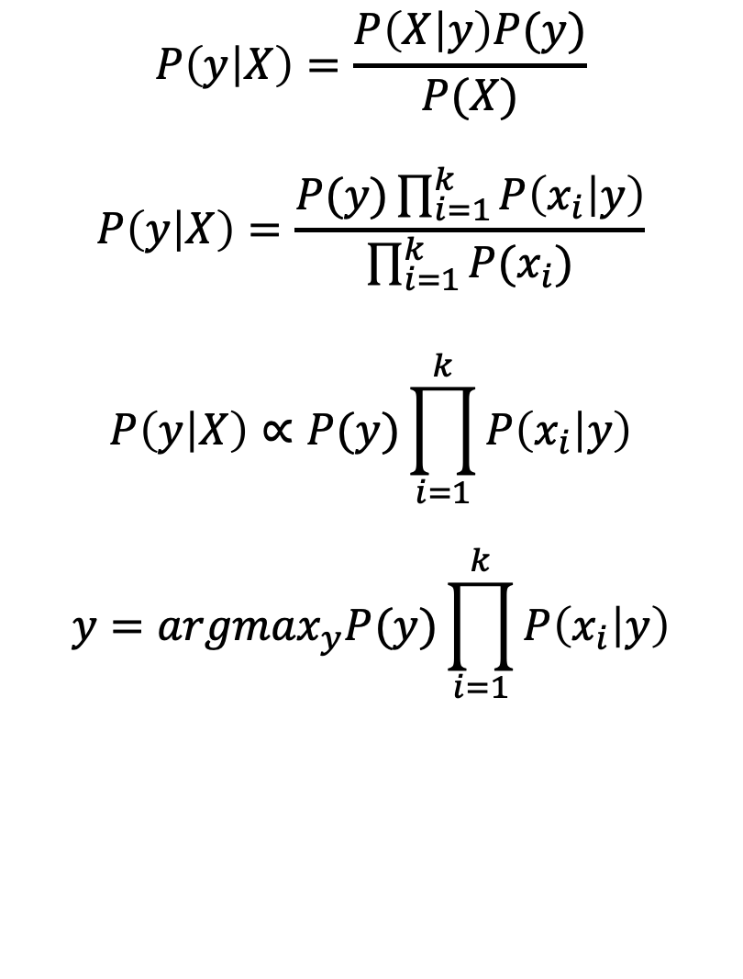
Naïve Bayes Classifier
$$P\left(y | X\right)=\frac{P\left(X | y\right)P(y)}{P(X)}$$
$$P\left(y | X\right)=\frac{P(y)\prod_{i=1}^{k}{P\left(x_{i} | y\right)}}{\prod_{i=1}^{k}{P(x_{i})}}$$
$$P\left(y | X\right)∝P(y)\prod_{i=1}^{k}{P\left(x_{i} | y\right)}$$
$$y={argmax}_{y}P(y)\prod_{i=1}^{k}{P\left(x_{i} | y\right)}$$
Bayes theorem:
(Naïve) assumption of conditional independence:
Proportion simplification:
Full classifier:

Slide 14
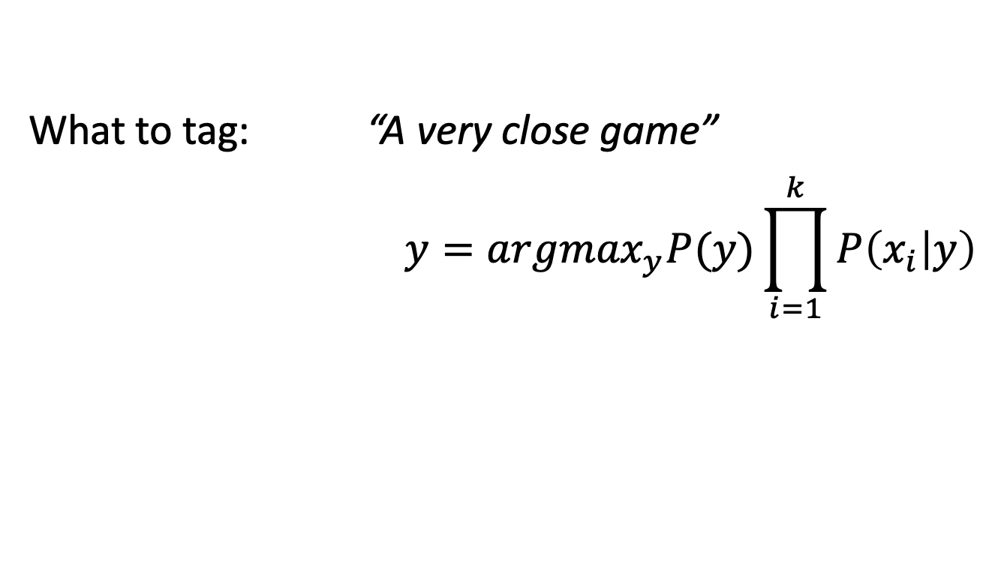
Bernoulli Naïve Bayes
Text | Tag
"A great game" | Sports
"The election was over" | Not Sports
"Very clean match" | Sports
"A clean but forgettable game" | Sports
"It was a close election" | Not Sports
What to tag: “A very close game”
$$y={argmax}_{y}P(y)\prod_{i=1}^{k}{P\left(x_{i} | y\right)}$$

Slide 15

Laplacian smoothing
Add a pseudo-count of $α=1$ to all counts
 | “a” | “very” | “close” | “game”
Sports | 2+1=3 | 1+1=2 | 0+1=1 | 2+1=3
P( x | Sports) | 3/4 | 2/4 | 1/4 | 3/4
Not Sports | 1+1=2 | 0+1=1 | 1+1=2 | 0+1=1
P( x | Not Sports) | 2/3 | 1/3 | 2/3 | 1/3
 | “a” | “very” | “close” | “game”
Sports | 2 | 1 | 0 | 2
P( x | Sports) | 2/3 | 1/3 | 0/3 | 2/3
Not Sports | 1 | 0 | 1 | 0
P( x | Not Sports) | 1/2 | 0/2 | 1/2 | 0/2
 | “a” | “very” | “close” | “game”
Sports | 2+1=3 | 1+1=2 | 0+1=1 | 2+1=3
P( x | Sports)
Not Sports | 1+1=2 | 0+1=1 | 1+1=2 | 0+1=1
P( x | Not Sports)

Slide 16
Multinomial Naïve Bayes

Slide 17
Homework
HW3 is due tomorrow (Sept. 27) at midnight
Programming Assignment 1 is due October 12

